Slide 1


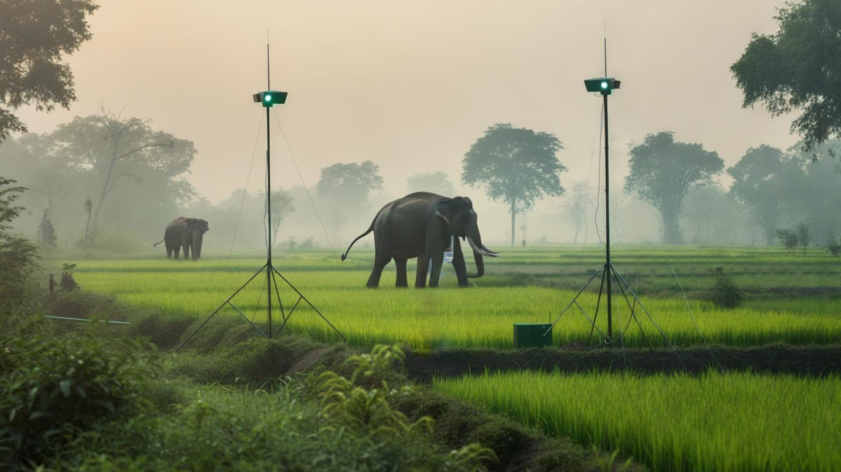
SIH – 2K25
Problem Statement ID – 25167
Problem Statement Title – AI & IoT Powered Intelligent System for Real-Time Elephant Movement Detection & Prevention of Human-Elephant Conflict (HEC)
Theme – Agriculture & Rural Development / Environment & Sustainability
PS Category – Hardware
Team ID –
Team Name – CRIMSON CREW

Slide 2
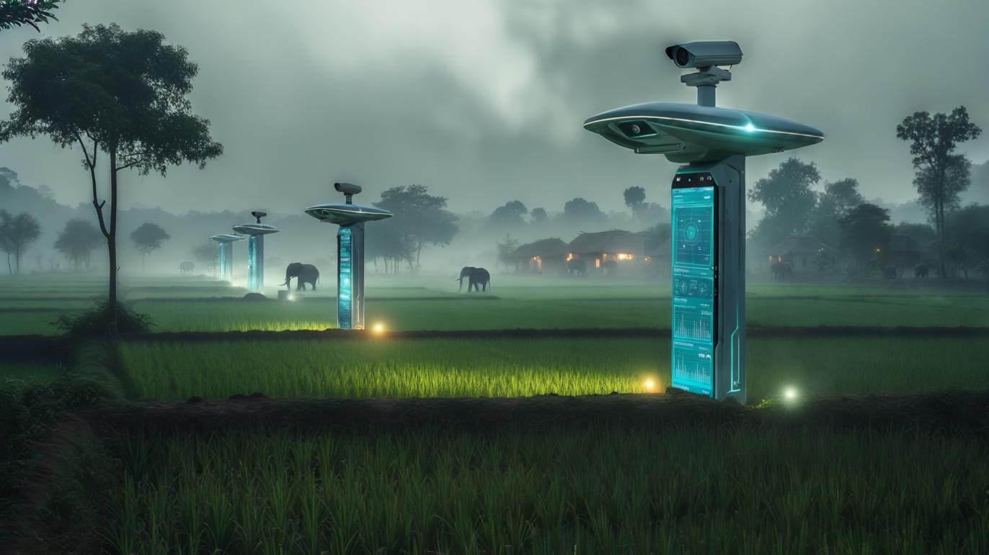

Proposed Solution:
IoT-based smart surveillance & alert system for villages & forest borders.
Multimodal sensors (thermal/IR cameras, PIR, acoustic, vibration, drones).
AI/ML algorithms for vision & audio classification on edge devices.
Real-time alerts via mobile app, SMS, loudspeakers, sirens.
Non-harmful deterrents (lights, ultrasonic sound, chili-smoke, drones).
Cloud dashboard for hotspot detection, movement prediction & analytics.
Innovation & Uniqueness:
Multimodal fusion (vision + audio + vibration) to reduce false positives.
Edge AI inference for real-time detection without internet dependency.
Solar-powered, low-cost, durable hardware for remote rural deployment.
Predictive analytics for migration patterns using AI + GIS.

Slide 3
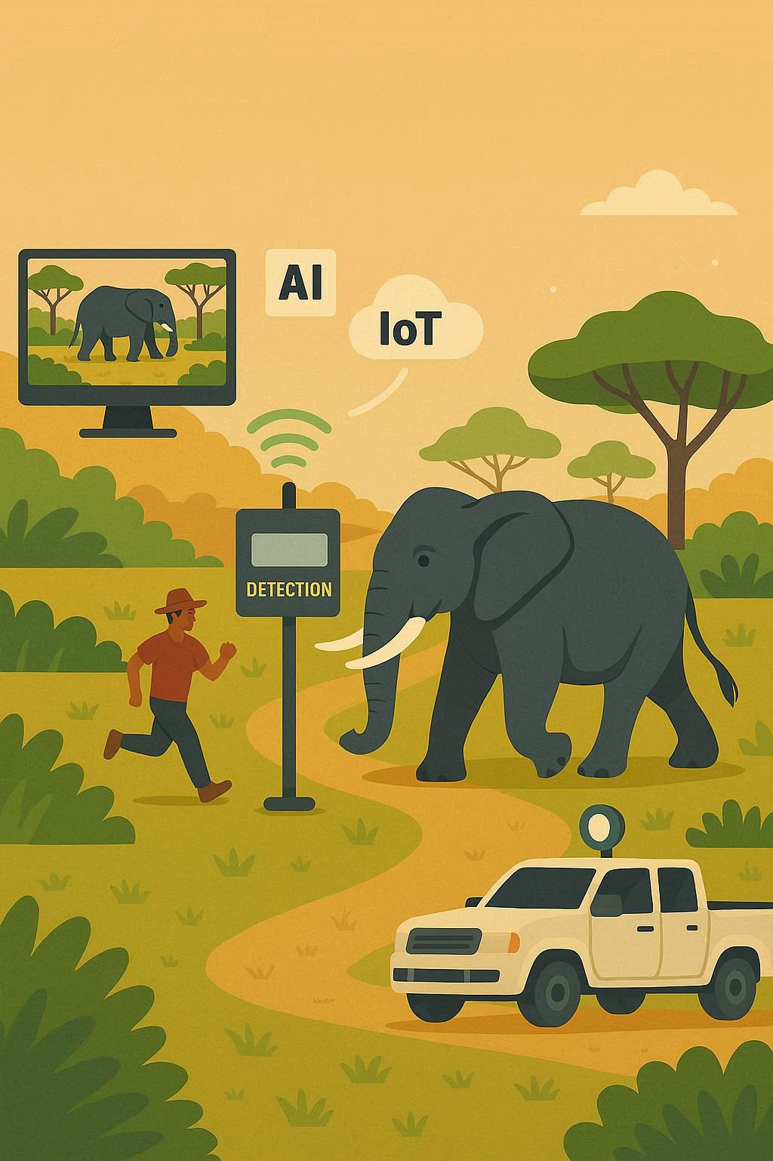
Technologies & Methodology
Technologies:
Methodology:
Hardware: Raspberry Pi / Jetson Nano, Thermal & RGB cameras, PIR, acoustic & vibration sensors, LoRa/GSM, Solar panels.
Data Collection – elephant images, audio, vibration data.
Model Training – AI models trained & optimized for edge devices.
Software & AI: YOLOv8 / MobileNetV3 for object detection, CNN for audio, Edge AI (TensorFlow Lite/PyTorch), Cloud + GIS dashboard (Leaflet/Mapbox), Android app.
Real-time Detection – fusion of camera + audio + vibration signals.
Alerts & Deterrents – SMS, app notifications, loudspeakers, lights.
Predictive Analytics – migration route forecasting via AI models.
Dashboard – centralized monitoring for forest officials.

Slide 4
Feasibility, Challenges & Mitigation
Feasibility:
Challenges & Risks:
Uses readily available, low-cost hardware (Raspberry Pi, sensors).
False positives due to cattle or humans.
Solar-powered → works in rural/forest areas without electricity.
Harsh weather may damage equipment.
Edge AI → minimizes internet dependence.
Connectivity issues in remote areas.
Mitigation Strategies:
False Positives
Harsh Weather
Sensor fusion + conservative detection thresholds.
Rugged, weatherproof enclosures.
Connectivity Issues
System Upkeep
Use LoRa mesh + GSM fallback for connectivity.
Community involvement for system upkeep.

Slide 5

Impact & Scalability
Societal Impact:
Technological Impact:
Saves human lives & prevents property/crop losses.
Demonstrates integration of AI + IoT + Edge Computing in rural areas.
Protects elephants & reduces conflict incidents.
Environmental Impact:
Economic Impact:
Supports wildlife conservation & biodiversity protection.
Reduces agricultural losses.
Aligns with SDG 13 (Climate Action) & SDG 15 (Life on Land).
Lowers government spending on conflict management.
Scalability:
Deployable in other states with elephant conflict (Odisha, Jharkhand, Assam, Kerala).

Slide 6


References
Research papers on human-elephant conflict in India (MoEFCC, WII reports).
Public datasets of elephant images & sounds (Wildlife AI, ElephantVoices).
Case studies on IoT-based wildlife monitoring (WWF projects, Drone surveillance).
References on AI-based predictive analytics for animal migration.
Government reports: “Human-Elephant Conflict Mitigation in India” – MoEFCC.

